Slide 3
EDASC Signature Investors

Slide 4
Industry employment trends
Anneliese Vance-Sherman, Ph.D.
Chief Economist
Employment security department

Slide 5
Job recovery was relatively swift

Slide 6
Labor force recovery took a bit longer

Slide 7
Labor force participation is recovering somewhat, but part of a long-term trend

Slide 8
The unemployment rate was 3.6% in July

Slide 9
Washington’s unemployment rate is close to the national rate of 3.5%

Slide 10
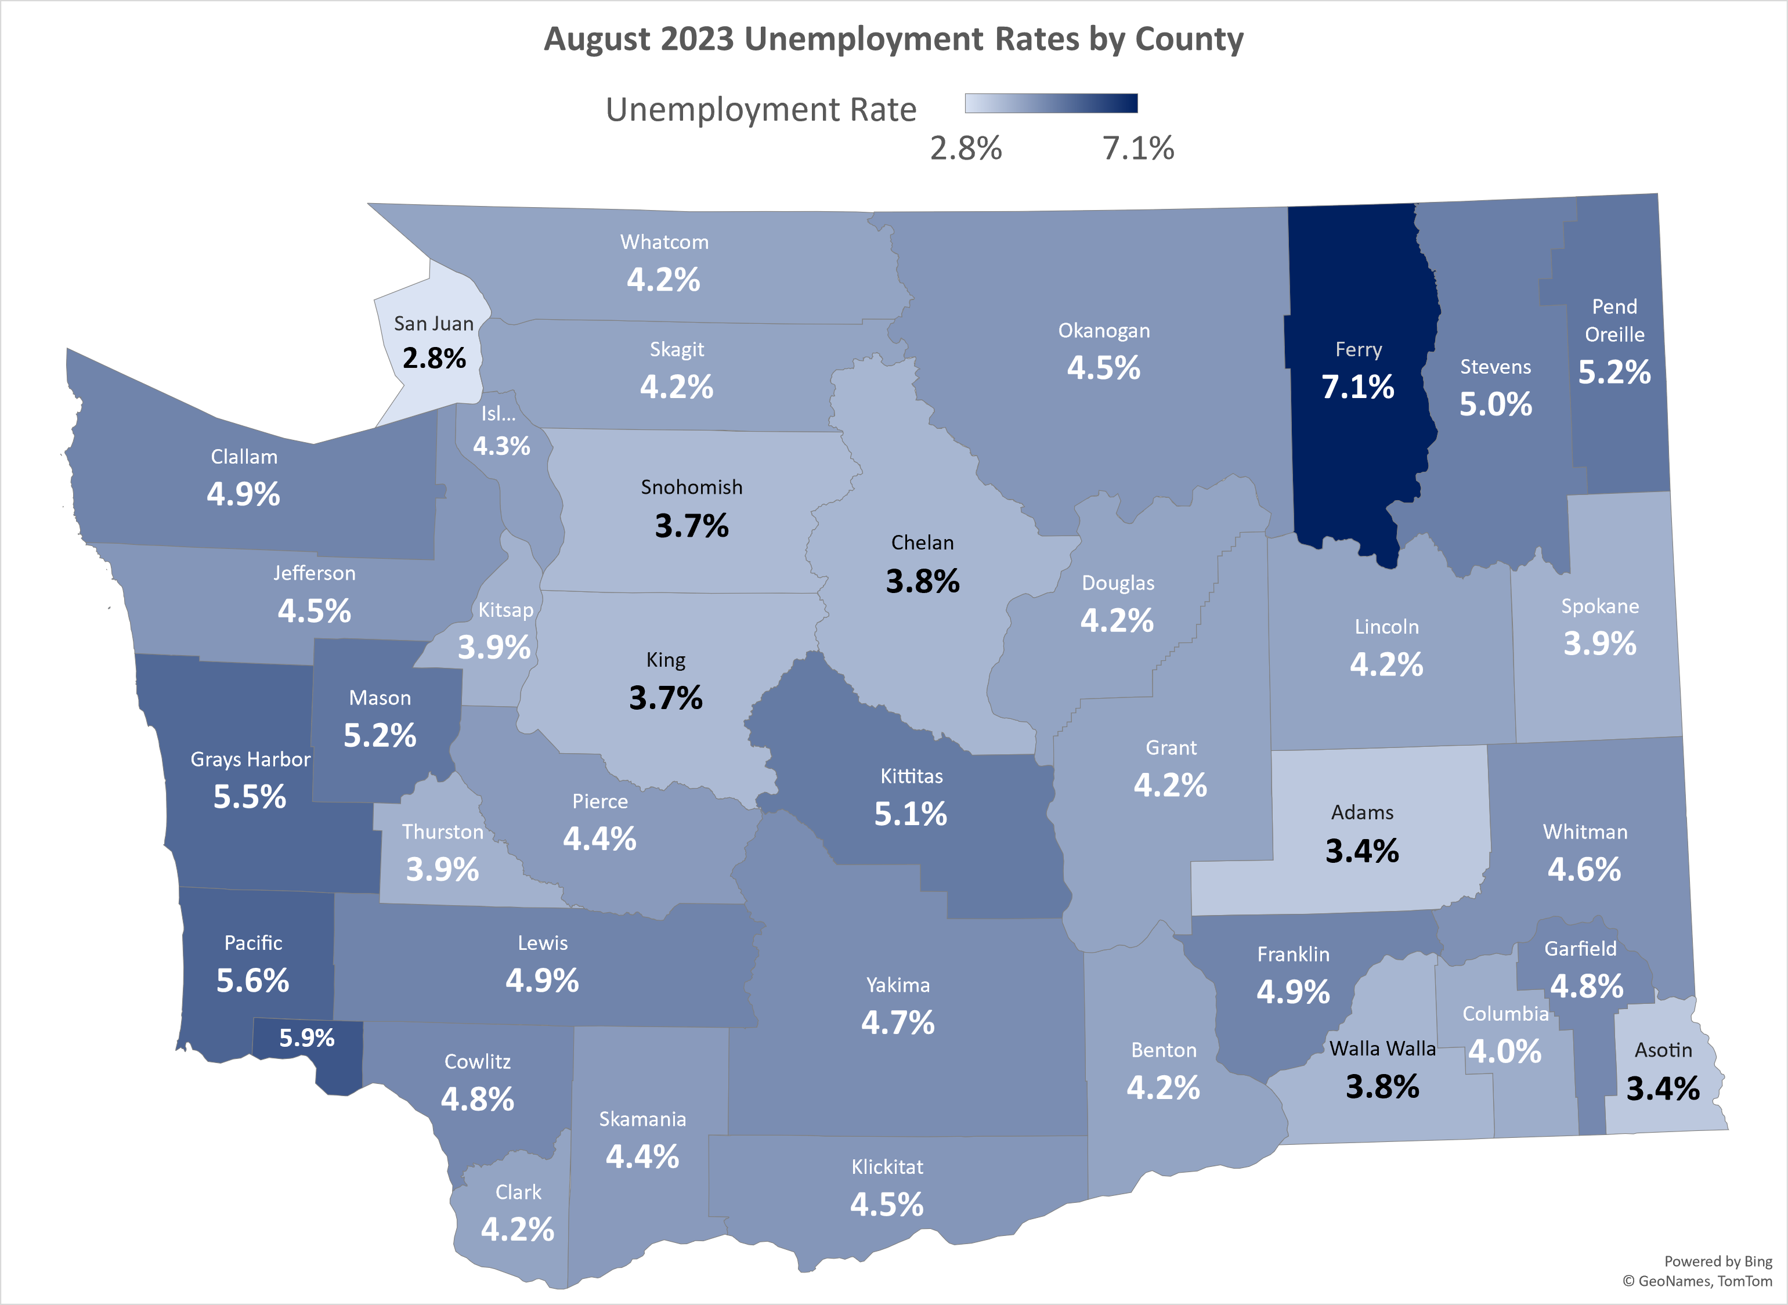
Unemployment varies by location

Slide 11
Labor force participation rates vary by population characteristics

Slide 12
Unemployment rates also vary by population characteristics

Slide 13
Washington JOLTS: Hires & Separations (labor turnover)

Slide 14
Washington JOLTS: Voluntary & involuntary separations

Slide 15
Washington JOLTS: Job openings & quit rates are related

Slide 16
Unemployed persons per job opening:

Slide 17
Industries were impacted differently:

Slide 18
Some sectors have yet to recover:

Slide 19
Some sectors bounced back quickly:

Slide 20
Pandemic job losses and recovery varied by location as well

Slide 21
Skagit County is similar to the state

Slide 22
Thank you!
Questions now or later?
Anneliese.Vance-Sherman@esd.wa.gov

Slide 23
Internships in Action Lynette Brower, Director

Slide 24
Expanding Your
Workforce Pipeline:
Engaging in K-12 Career Pathway Exploration ​

Slide 25
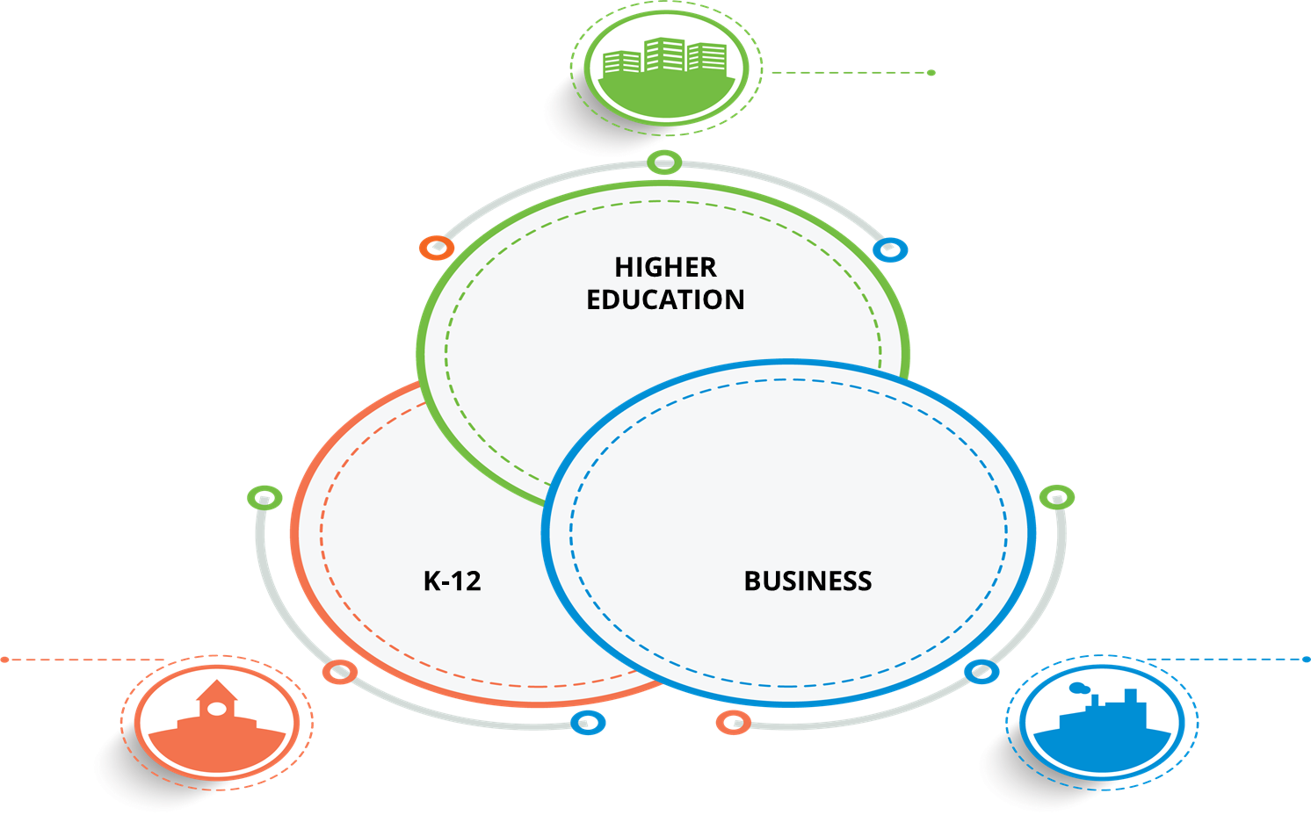
Career Connect NW
Network

Slide 26
Career Connect NW
Network
Hosted at the Northwest Educational Service District 189
Serves 5 counties: Skagit, San Juan, Island, Snohomish, and Whatcom
35 school districts, including 440+ schools and 165k+ students
Also work with community and youth organizations​
​
Top four key industries in our region include the following:
Healthcare Advanced Manufacturing Construction Information Technology
Additional focus includes marine trades, education, sustainability, and transportation
Notes:
Jenny

Slide 27
Ways to Get Involved
How to Get Involved
A few examples…
Notes:
Sinead

Slide 28
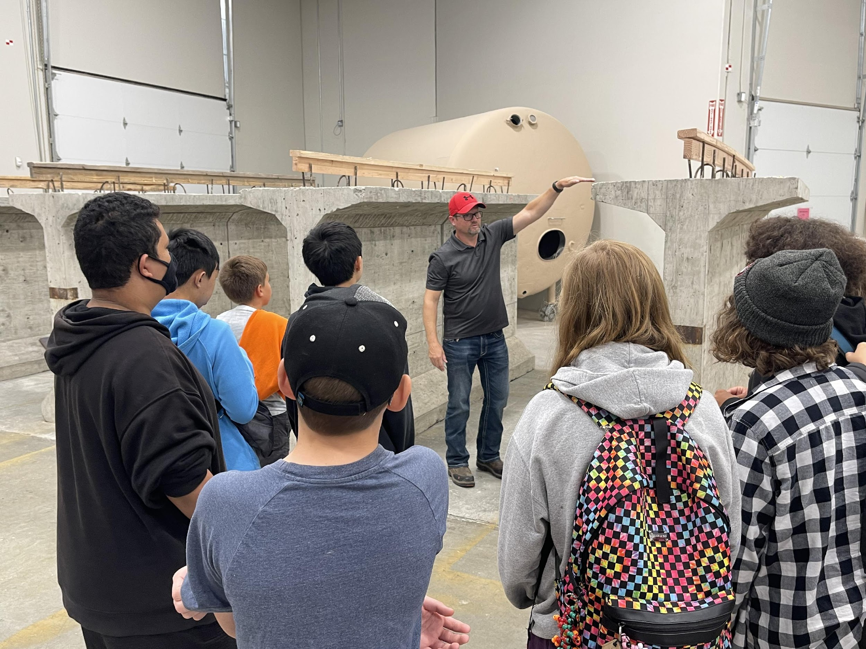
Worksite Tours
Dakota Creek Industries
Northwest Carpenters Institute
Sierra Pacific Industries
Whatcom Community College Healthcare Education Lab
Notes:
Sinead

Slide 29
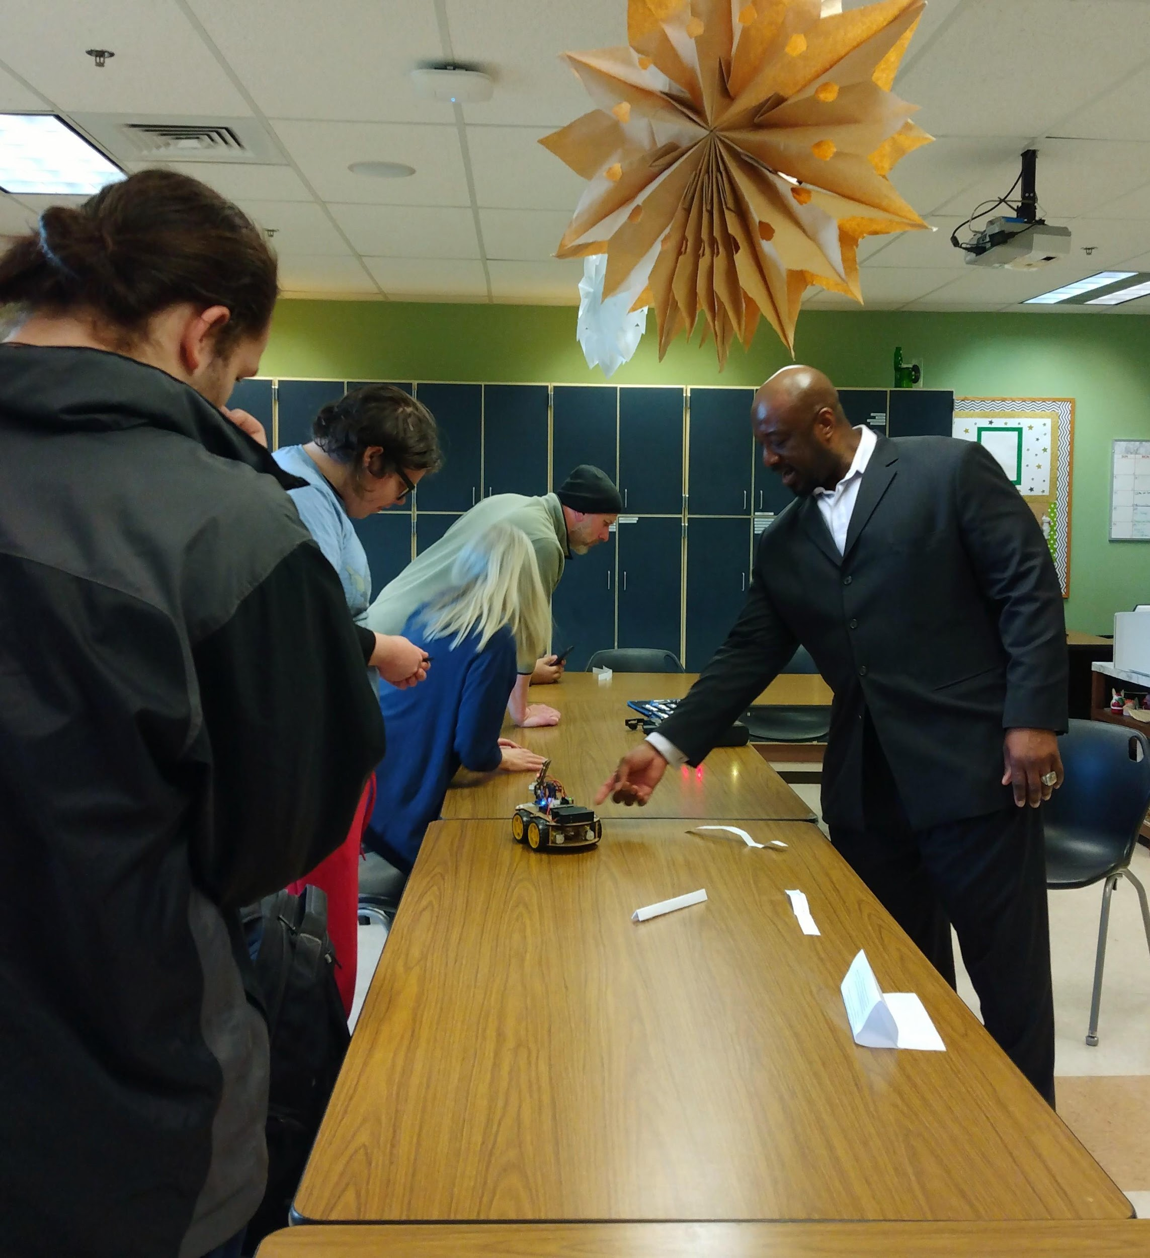
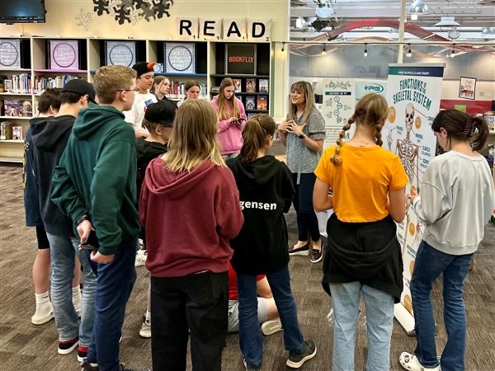
Classroom Speakers & STEM Like ME!SM
Notes:
Sinead

Slide 30
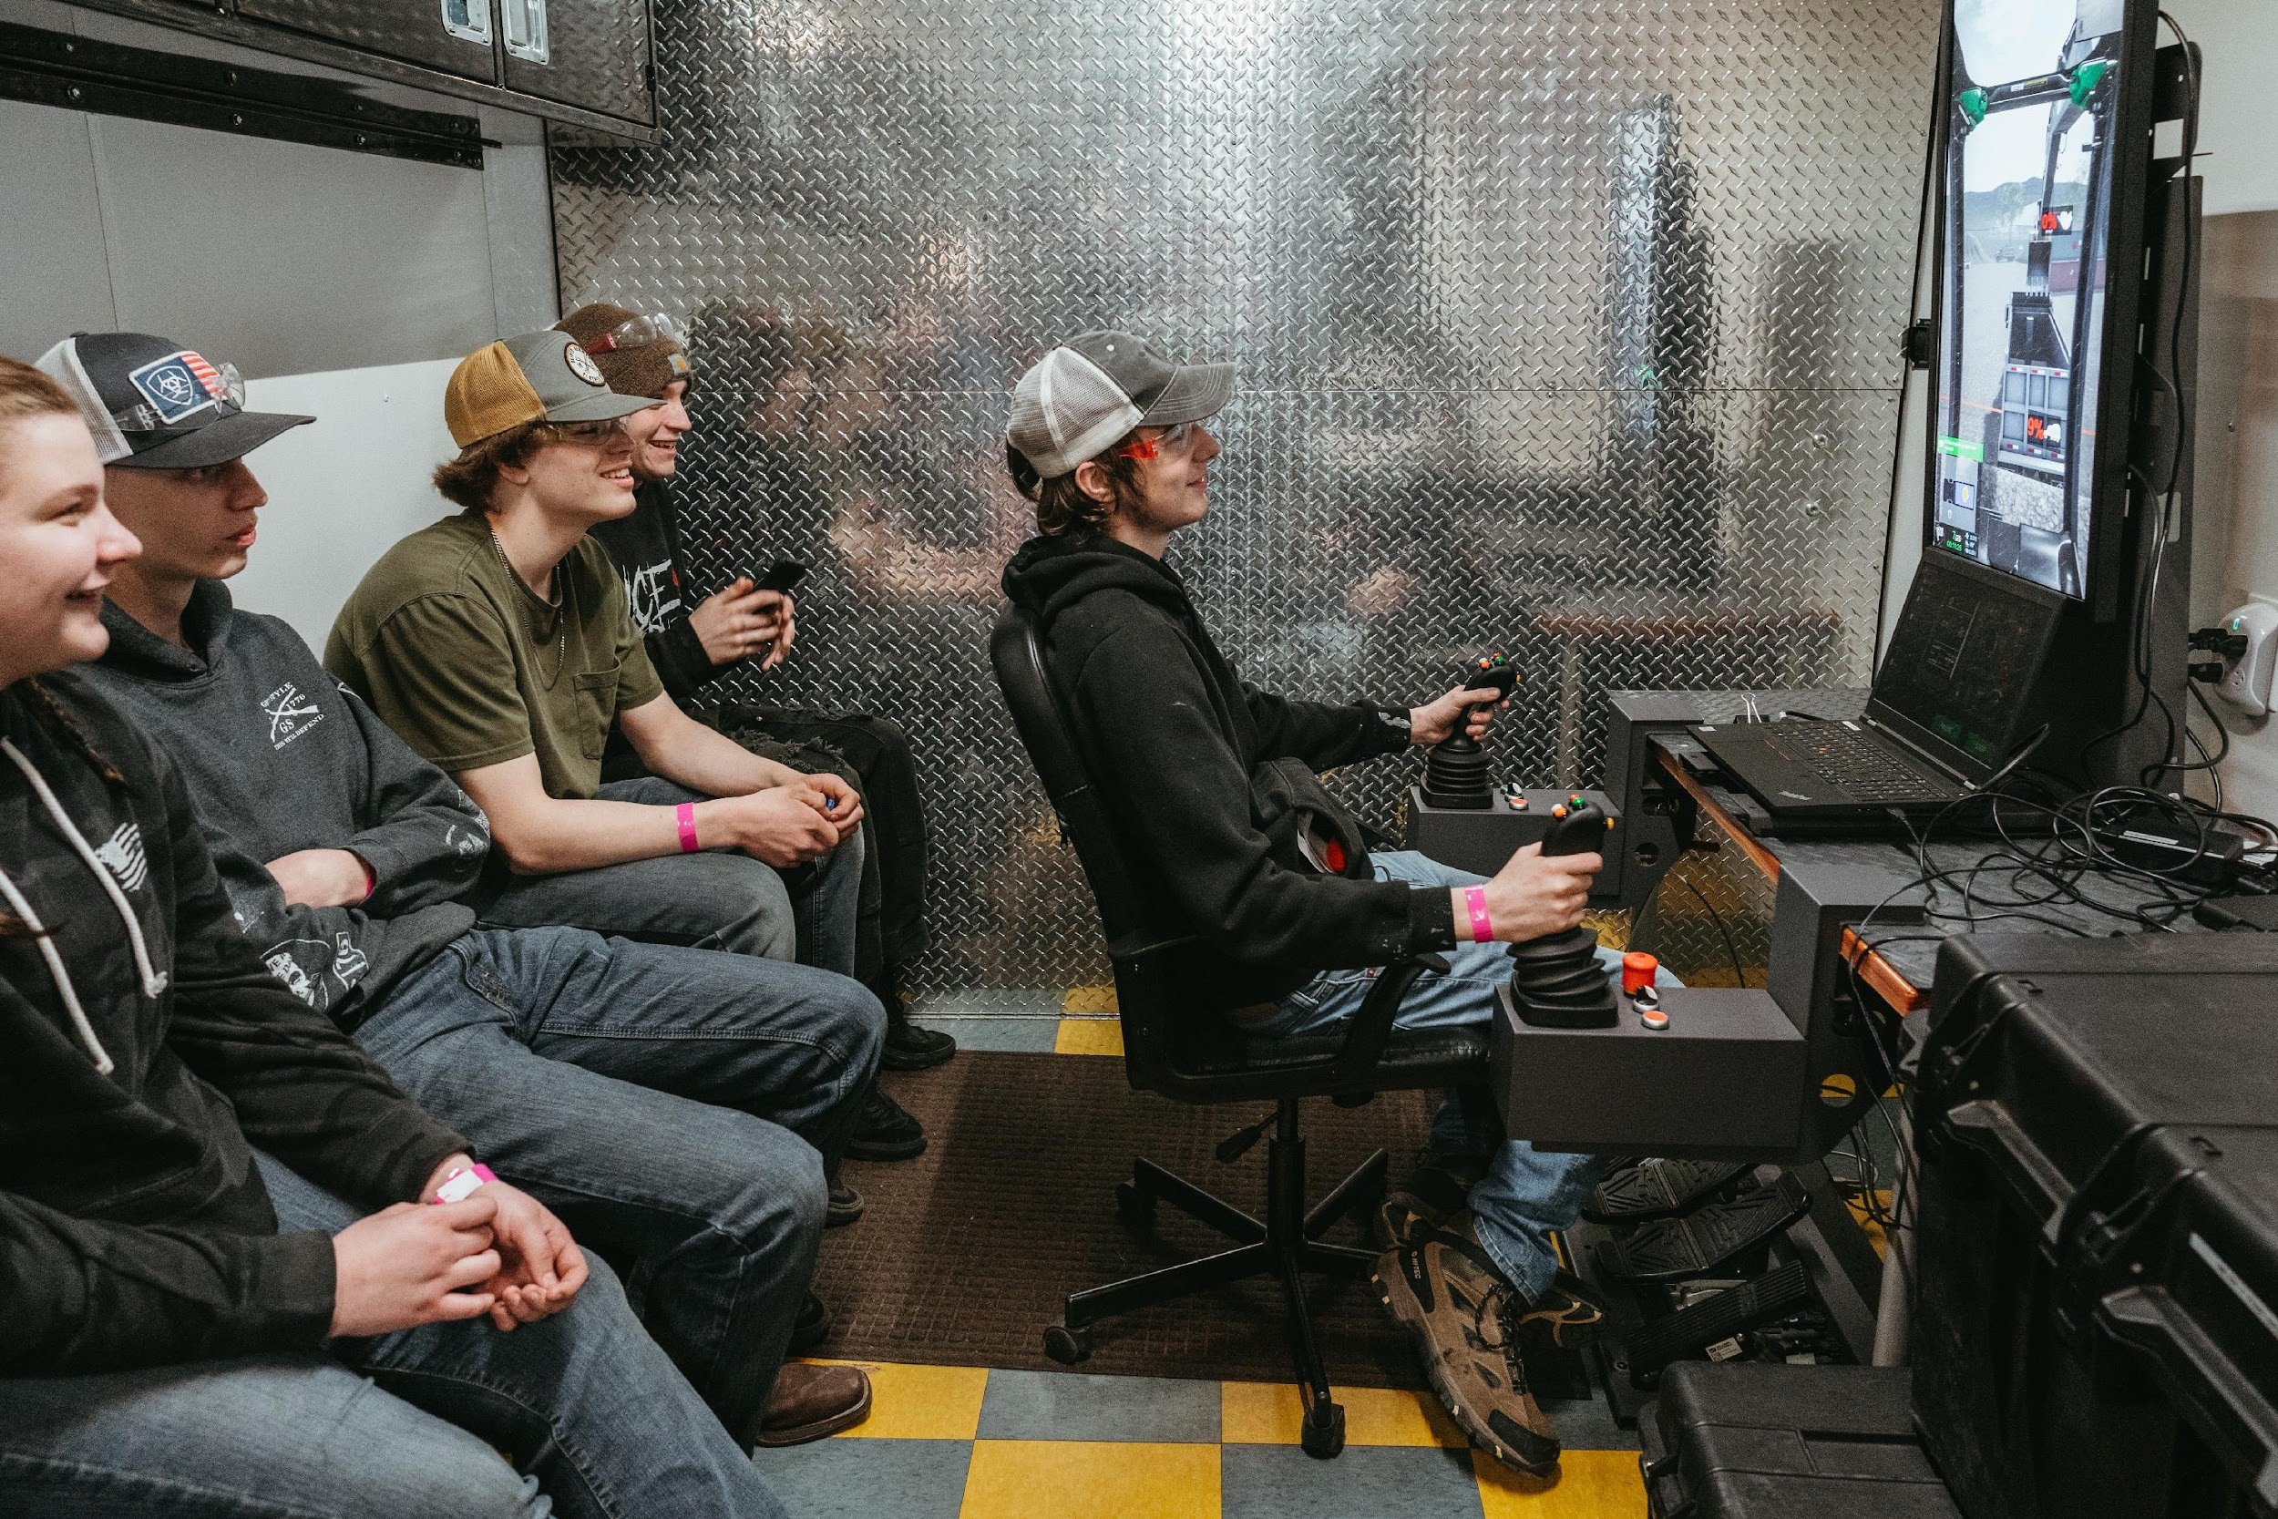
Large Multi-County Events (Trades, Healthcare, etc.)
Featured in the Skagit Valley Herald, April 26, 2023 "Local high school students get a hands-on look at apprenticeships"
Notes:
Sinead

Slide 31
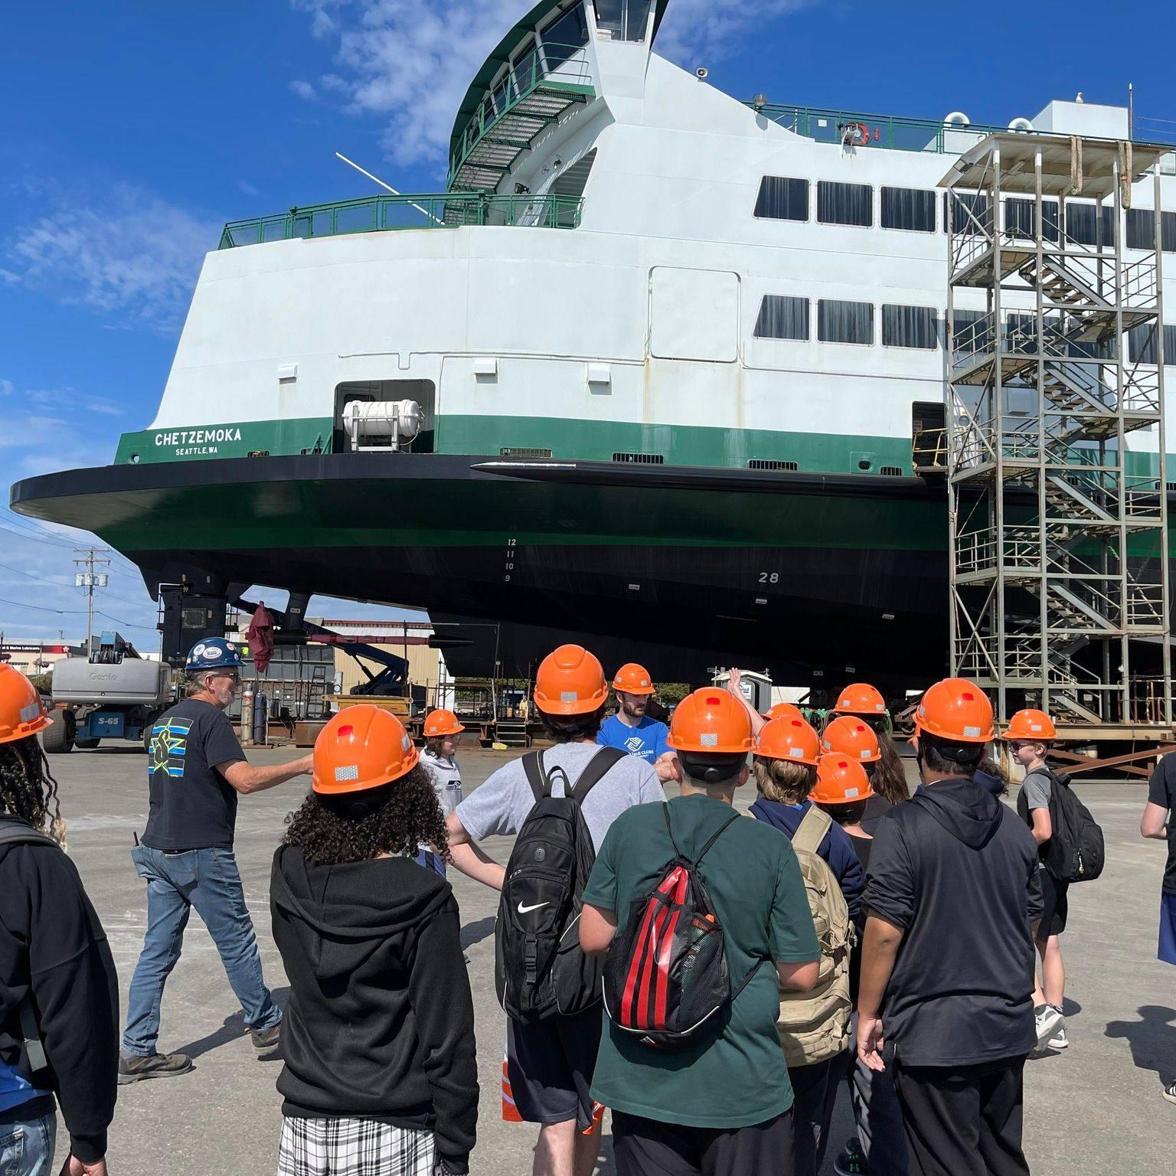
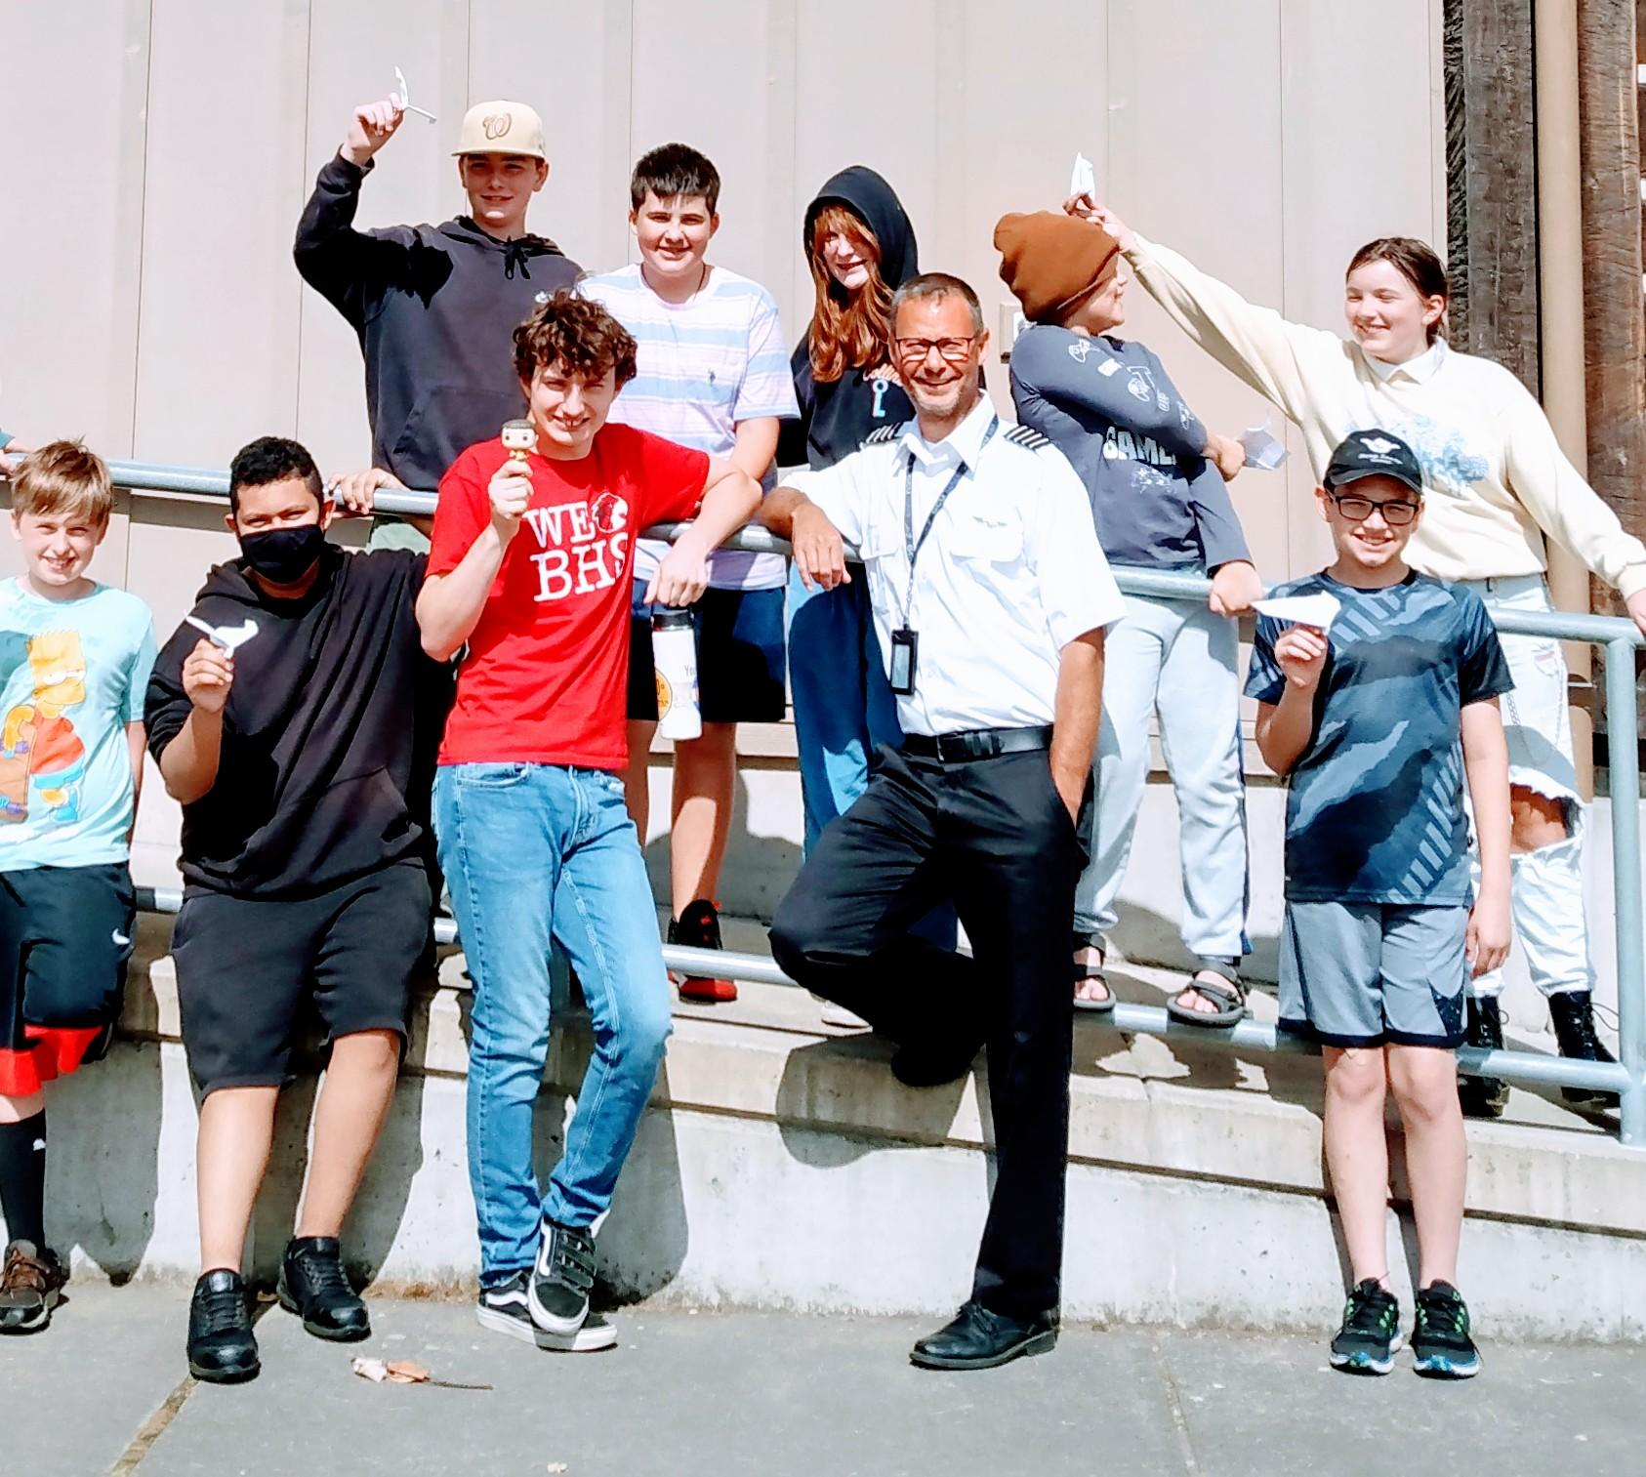
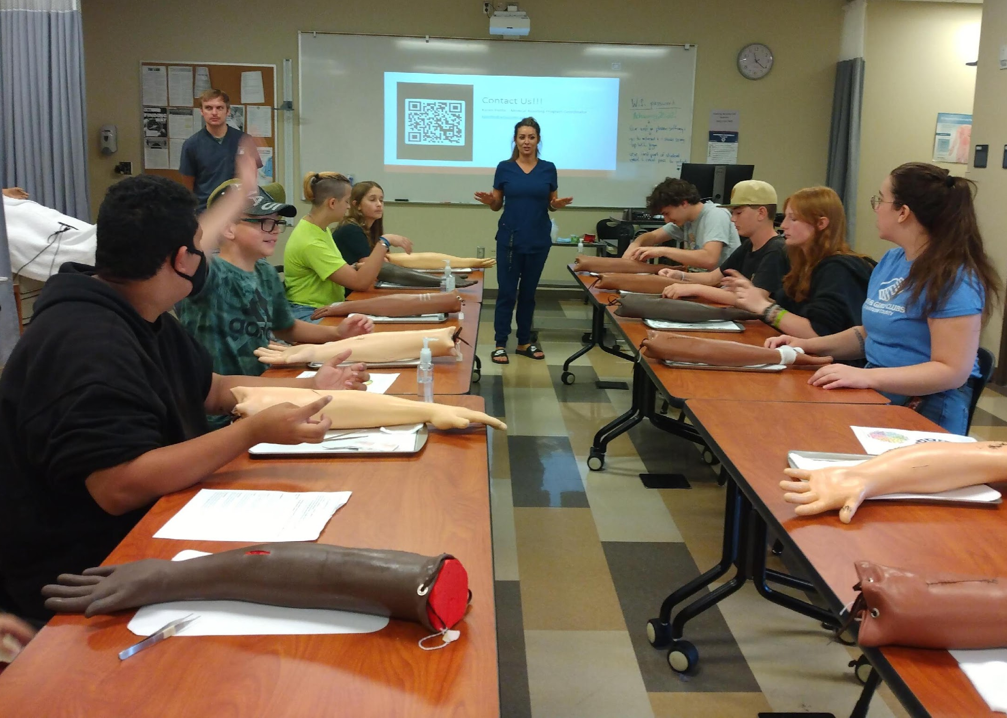
Business Partner Highlight – Boys & Girls Club of Whatcom County Mike Babauta & Workforce Wednesdays

Slide 32
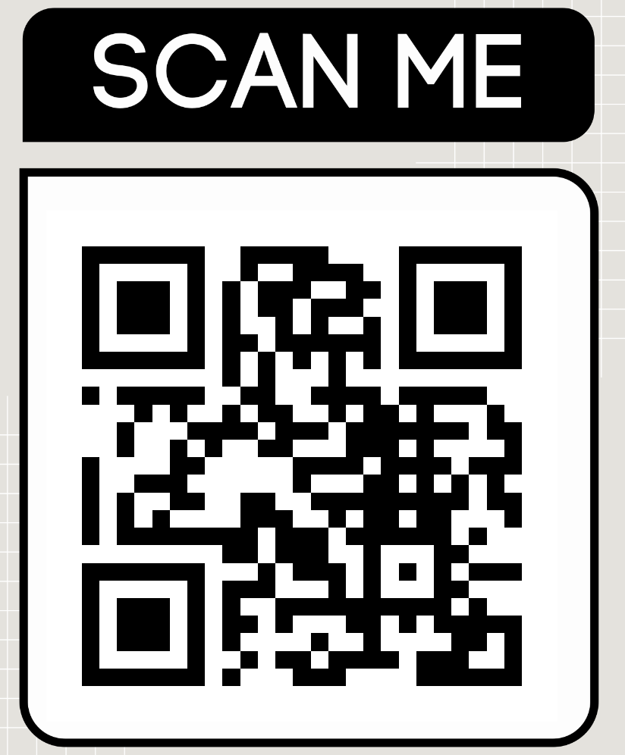
Let's Do This!
Don’t feel like you must be the “perfect” guest speaker.
Remember students and teachers are interested in you and your career.
We provide Guest Speaker Onboarding Training (usually 1 hour, can be virtual or in-person)
We provide support while you are in the classroom.
(QR to our webpage to enter your contact info)
Notes:
Sinead

Slide 33
We’ll be back soon!
10-minute break

Slide 34
Customized Training & Internships
Brittney Maruska (she/her)
Director of Business & Community Education
Skagit Valley College
brittney.maruska@skagit.edu

Slide 35
Internships
Elevate Your Business with Co-op Ed Interns!
Tap into Student Talent - Bridging Theory & Practice
Support Classroom Study and Career Goals
Co-op Education Programs:
Automotive Technology
Business
Craft Brewing
Culinary
Diesel Technology
Environmental Conservation
Fire Protection
Human Services
Manufacturing Technology
Multimedia Interactive Technology
Marine Technology
Welding

Slide 36
Diverse Training Opportunities
Continuing Education
Tailored Customized Training
Access to Job Skills Program Grants

Slide 37
Comprehensive Professional Development
Management Series
Diversity & Inclusion
Conflict Management
Public Speaking
Microsoft Trainings
Excel
Teams
Task Management
Notes:
Online & in-person
More to come!

Slide 38
Examples of Customized Training
Excel trainings on-site or at SVC
Executive leadership & emerging leaders trainings
Management & communication for new hires or supervisors
Train-the-trainer

Slide 39
Job Skills Program
Funding for longer-term training
Customized training plan
Dollar for dollar match

Slide 40
Brittney Maruska
Brittney.Maruska@skagit.edu
360.416.7750
www.skagit.edu/cce
www.skagit.edu/customizedtraining

Slide 41
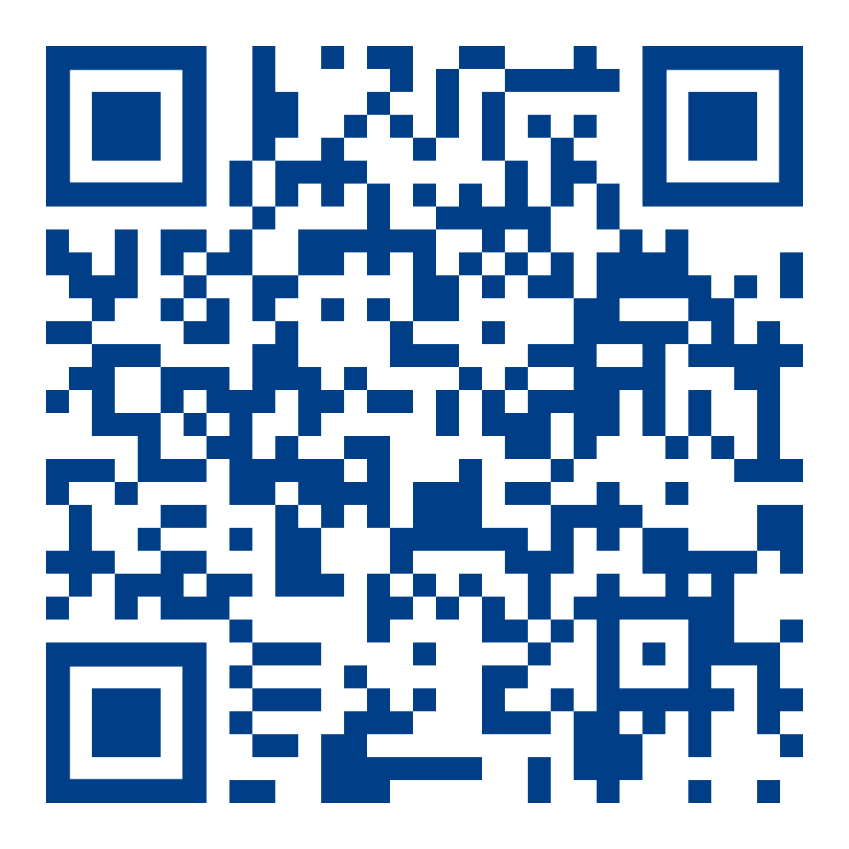
Connecting & Collaborating Western Washington University
Mindy Pelton
Director, WWU Career Services Center

Slide 42
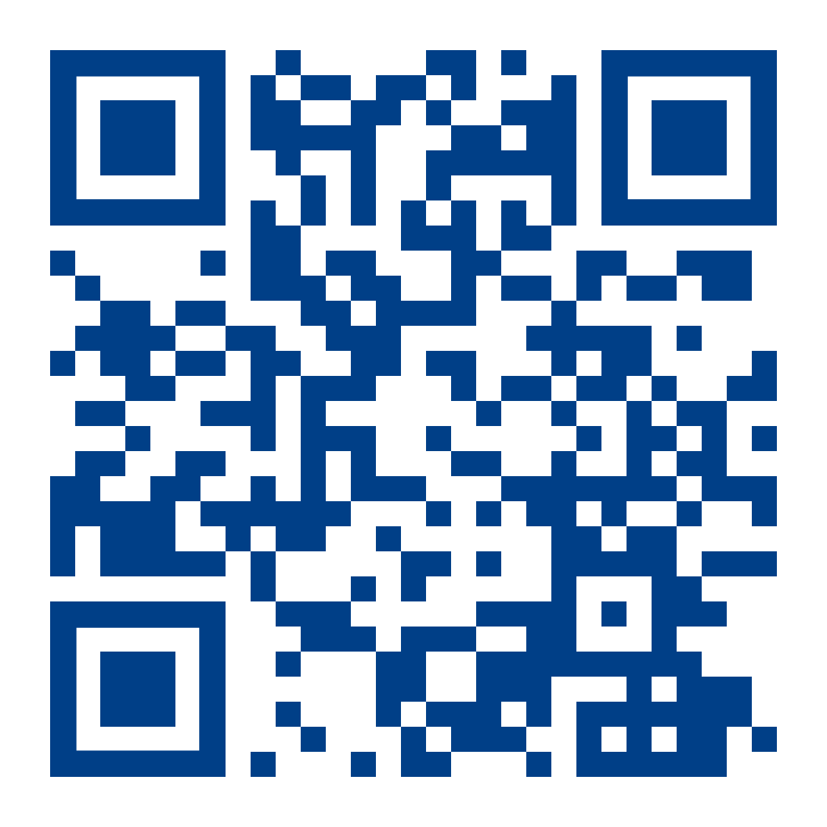
Academic Programs
Humanities & Social Sciences
Science & Engineering
Business & Economics
Fine & Performing Arts
Environment
Education
Fairhaven College
Graduate School
Mindy.Pelton@wwu.edu

Slide 43
Getting Involved: College of Business and Economics
Morgan Widden
Professional and Career Readiness Director
widdenm@wwu.edu

Slide 44
Getting Involved
Why
Meet and recruit top talent
Market to student job-seekers
Introduce real-word work to academics
How
Visit Campus
Tabling
Class or Club Speaker
Informational Interview Sessions
Mentorship
Other ideas? Let’s chat!

Slide 45
Example Company:
A company wanted:
To hire a student employee for an internship
How I helped:
Internal WWU communication
Write and share job descriptions
Organized a campus visit for the company
Helped the company prep to interview students

Slide 46
widdenm@wwu.edu
Morgan Widden
Professional and Career Readiness Director

Slide 47
COLLABORATION
The WWU MBA Program x Corporate Community Partnerships

Slide 48
WWU MBA Program – 3 Tracks

Slide 49
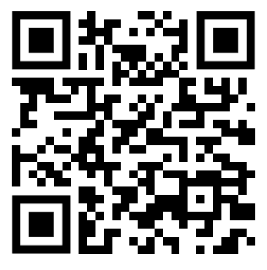
WWU MBA Program – Internships
100 hours of engagement
Can occur at any time over enrollment
Individual and team options
Contact:
Carmell Emory, MBA Career Services Email: carmell.emory@wwu.edu

Slide 50
WWU MBA Program – Capstone
2 Phase Capstone Experience
Phase 1 – Interdisciplinary Assessment
Phase 2 – Applied Consulting
8-10 weeks
4-6 students per team
Bi-Weekly engagement
Material outcomes

Slide 51
WWU MBA Program – Capstone
Project Case: Bow Hill Blueberries, Soltes Family Ownership
Year 1 Year 2 Year 3
Beyond Commodity
Brand and Product
Development
Omni-Channel Go-to-Market Strategy

Slide 52
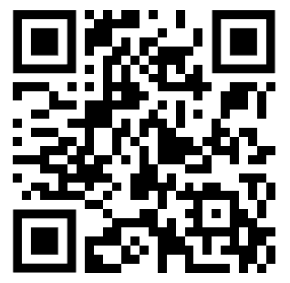
WWU MBA Program – Capstone
Projects launch late September
Project availability this Fall
Contact:
Lucas G Senger Email: lucas.senger@wwu.edu

